Slide 1
Visual simulator for high quality planning domain models
Software Engineering 2: Project Teamwork Mälardalen University
Group #2
Client : Ericsson
Contact : Swarup Kumar Mohalik

Slide 2
What we did last week
Sent in the first version of the detailed design description

Slide 3
What we did last week
Implemented classes corresponding to PDDL code
- Will be used by the parser from the VAL tool to instantiate a plan

Slide 4
What we did last week
Created a first version of the tool
Discord meeting yesterday to go through current implementation of the tool
Explained the implementation tasks to each member who did not attend the last sprint meeting

Slide 5
Encountered problems
Implementation of the first version of the tool took longer than expected

Slide 6
Worked hours
Members | W.4 | W.5 | Total
Marta | 19 | 22 | 41
Erik E | 22 | 22 | 44
Erik P | 19 | 17 | 36
Allan | 18 | 20 | 38
Laura | 20 | 17 | 37
Ermal | 18 | 15 | 33
Johannes | 20 | 19 | 39

Slide 7
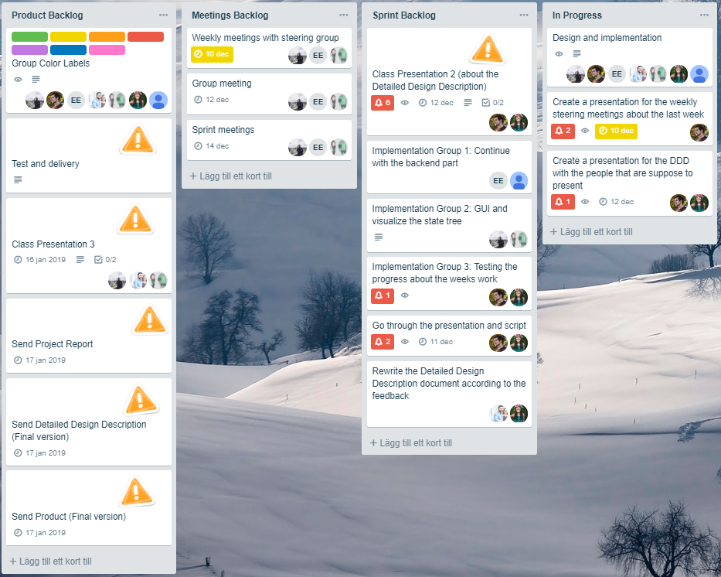
What are we doing this week

